Slide 1
CSE 350 Data Communication
Lecture 3: Data & Signals Math

Slide 2

Example 3.10
If a periodic signal is decomposed into five sine waves with frequencies of 100, 300, 500, 700, and 900 Hz, what is its bandwidth? Draw the spectrum, assuming all components have a maximum amplitude of 10 V. Solution
Let f_{h} be the highest frequency, f_{l} the lowest frequency, and B the bandwidth. Then

Slide 3
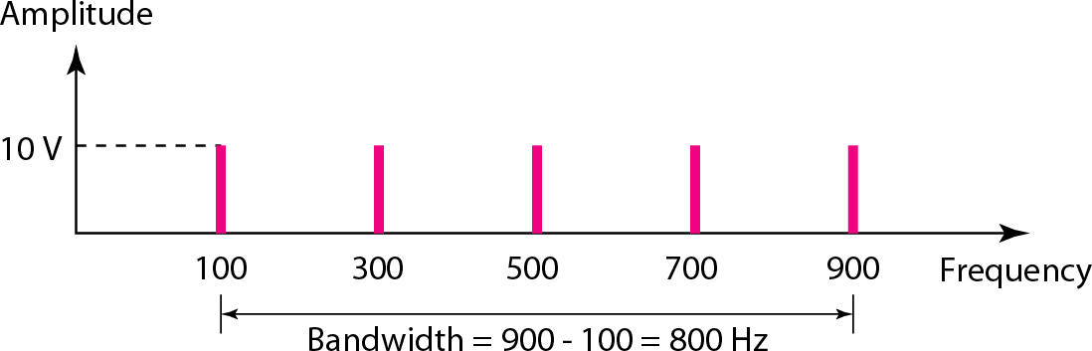
Figure 3.13 The bandwidth for Example 3.10
The spectrum has only five spikes, at 100, 300, 500, 700,
and 900 Hz.

Slide 4
Example 3.11
A periodic signal has a bandwidth of 20 Hz. The highest frequency is 60 Hz. What is the lowest frequency? Draw the spectrum if the signal contains all frequencies of the same amplitude.
Solution
Let f_{h} be the highest frequency, f_{l} the lowest frequency, and B the bandwidth. Then
The spectrum contains all integer frequencies. We show this by a series of spikes (see Figure 3.14).

Slide 5
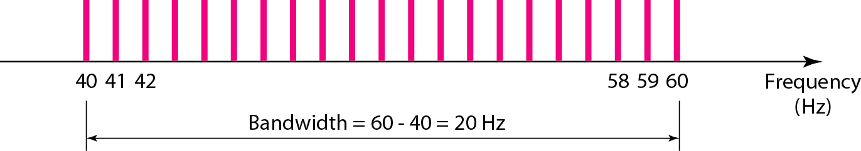
Example 3.11
Figure 3.14 The bandwidth for Example 3.11

Slide 6
Example 3.12
A nonperiodic composite signal has a bandwidth of 200 kHz, with a middle frequency of 140 kHz and peak amplitude of 20 V. The two extreme frequencies have an amplitude of 0. From 0v to the 20v, the spectrum linear increase or decrease. Draw the frequency domain of the signal.
Solution
The lowest frequency must be at 40 kHz and the highest at 240 kHz. Figure 3.15 shows the frequency domain and the bandwidth.

Slide 7
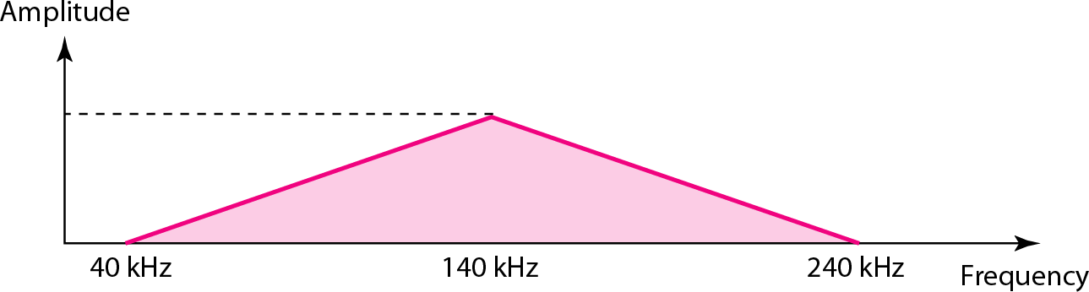
Example 3.12
Figure 3.15 The bandwidth for Example 3.12

Slide 8

Example 3.16
A digital signal has eight levels. How many bits are needed per level? We calculate the number of bits from the formula
Each signal level is represented by 3 bits.
Bit Rate: number of bits sent in 1 second. bps: bit per second

Slide 9
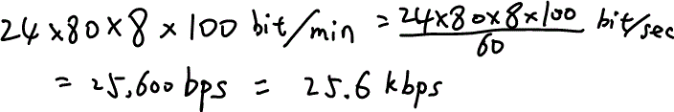
Example 3.18
Assume we need to download text documents at the rate of 100 pages per minute. What is the required bit rate of the channel? (assuming each page is an average of 24 lines with 80 characters in each line, and one character requires 8 bits)
Solution
the bit rate is (the solution on text book is wrong!)

Slide 10

Example 3.19
What is the bit rate for high-definition TV (HDTV)? Solution
HDTV uses digital signals to broadcast high quality video signals. The HDTV screen is normally a ratio of 16 : 9. There are 1920 by 1080 pixels per screen, and the screen is renewed 30 times per second. 24 bits represents one color pixel.
The TV stations reduce this rate to 20 to 40 Mbps through compression.

Slide 11
In baseband transmission, the required bandwidth is proportional to the bit rate; if we need to send bits faster, we need more bandwidth.

Slide 12
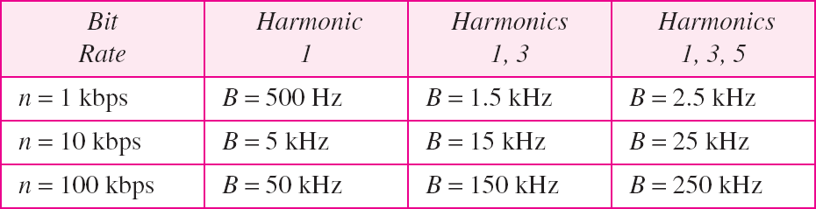
Table 3.2 Bandwidth requirements for different bitrate

Slide 13
Example 3.22
What is the required bandwidth of a low-pass channel if we need to send 1 Mbps by using baseband transmission?
Solution
The answer depends on the accuracy desired.
The minimum bandwidth, is B = bit rate /2, or 500 kHz.
A better solution is to use the first and the third harmonics with B = 3 × 500 kHz = 1.5 MHz.
Still a better solution is to use the first, third, and fifth harmonics with B = 5 × 500 kHz = 2.5 MHz.

Slide 14
If the available channel is a bandpass channel, we cannot send the digital signal directly to the channel (why?); we need to convert the digital signal to an analog signal before transmission.

Slide 15
Attenuation: Decibel
Measures the relative strength of two signals.
Or one signal at two different points (attenuation).
P1,P2: power of signal at points 1 and 2, respectively.
P2 P1
dB = 10log
10
P2: Power at receiver P1: Power at sender

Slide 16
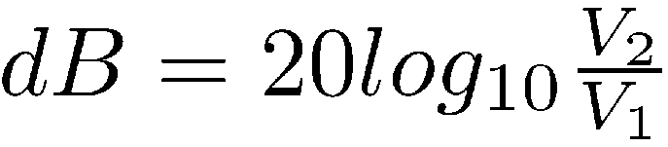
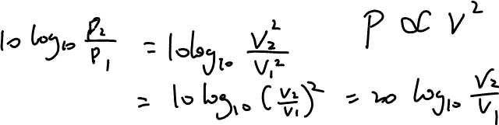
Attenuation: Decibel
Some books define dB in term of voltage of signal
This is because power is proportional to square of voltage

Slide 17
Example 3.26
Suppose a signal travels through a transmission medium and its power is reduced to one-half. This means that P₂ is (1/2)P₁. In this case, the attenuation (loss of power) can be calculated as
A loss of 3 dB (–3 dB) is equivalent to losing one-half the power. (what does a gain of 3dB means?)

Slide 18

Example 3.27
A signal travels through an amplifier, and its power is increased 10 times. This means that P₂ = 10P₁ . In this case, the amplification (gain of power) can be calculated as
Concept: 3dB means power decrease by half (increase by double) 10dB means 10 times increase/decrease

Slide 19

Example 3.29
Sometimes the decibel is used to measure signal power in milliwatts. In this case, it is referred to as dBm and is calculated as dBm = 10 log₁₀ P_{m} , where P_{m} is the power in milliwatts. Represent the power in milliwatts of a signal with -30dBm.
Solution
We can calculate the power in the signal as

Slide 20
Signal-to-Noise Ratio (SNR)
_{SNR =} avsp
avnp
avsp = average signal power
avnp = average noise power
Decibel unit:
SNR_{dB} = 10log₁₀ SNR

Slide 21
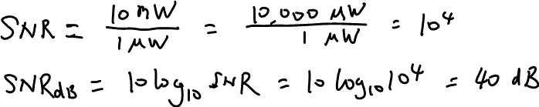
Example 3.31
The power of a signal is 10 mW and the power of the noise is 1 μW; what are the values of SNR and SNR_{dB} ?
Solution
The values of SNR and SNR_{dB} follows:
can be calculated as

Slide 22
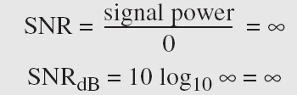
Example 3.32
The values of SNR and SNR_{dB} for a noiseless channel are
We can never achieve this ratio in real life; it is an ideal.

Slide 23
Nyquist theorem
For a noiseless channel:
Theoretic Max BitRate = 2Blog₂ L
B: bandwidth (Hz)
L: number of levels

Slide 24

Example 3.34
Consider a noiseless channel with a bandwidth of 3000 Hz transmitting a signal with two signal levels. The maximum bit rate can be calculated as

Slide 25

Example 3.35
Consider the same noiseless channel transmitting a signal with four signal levels (for each level, we send 2 bits). The maximum bit rate can be calculated as

Slide 26
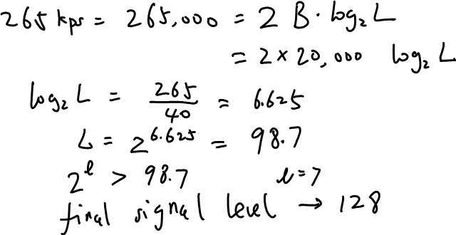
Example 3.36
We need to send 265 kbps over a noiseless channel with a bandwidth of 20 kHz. How many signal levels do we need? (hint: signal level needs to be 2^{l})
Solution
We can use the Nyquist formula as shown:

Slide 27
Noisy Channel: Shannon Capacity
Max bitRate C = B log₂ (1+SNR)
B : bandwidth (Hz)
SNR: signal-to-noise ratio
No matter how many levels we use for signal
Intuition: if noise is bigger, signal level cannot be too bigger in order to correctly read received signal.
Question: what is the minimum SNR?

Slide 28
Example 3.37
Consider an extremely noisy channel in which the value of the signal-to-noise ratio is almost zero. In other words, the noise is so strong that the signal is faint. For this channel the capacity C is calculated as
This means that the capacity of this channel is zero regardless of the bandwidth. In other words, we cannot receive any data through this channel.

Slide 29
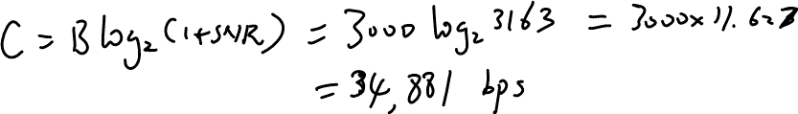
Example 3.38
We can calculate the theoretical highest bit rate of a regular telephone line. A telephone line normally has a bandwidth of 3000Hz. The signal-to-noise ratio is usually 3162. For this channel the capacity is calculated as
This means that the highest bit rate for a telephone line is 34.860 kbps. If we want to send data faster than this, we can either increase the bandwidth of the line or improve the signal-to-noise ratio.

Slide 30
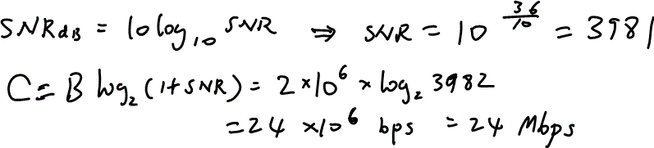
Example 3.39
The signal-to-noise ratio is often given in decibels. Assume that SNR_{dB} = 36 dB and the channel bandwidth is 2 MHz. The theoretical channel capacity can be calculated as

Slide 31
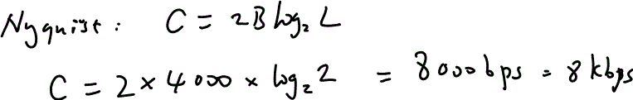
Example 3.42
The bandwidth of a subscriber line is 4 kHz for voice or data. The bandwidth of this line for data transmission can be up to 56,000 bps using a sophisticated modem to change the digital signal to analog.
What is the max bit rate if the signal level is 2 (binary signal) under noiseless condition?

Slide 32

Example 3.44
A network with bandwidth of 10 Mbps can pass only an average of 12,000 frames per minute with each frame carrying an average of 10,000 bits. What is the throughput of this network?
Solution
We can calculate the throughput as
The throughput is almost one-fifth of the bandwidth in this case.

Slide 33
Latency (delay)
Defines how long it takes for an entire message to completely arrive at the destination from the time the first bit is sent out from the source.
Latency = propagation time+ transmission time+ queuing time+ processing delay

Slide 34
Propagation time
Measures the time required for a bit to travel from the source to the destination.
Pr opagationTime = ^{dis tan ce}
propagationspeed

Slide 35
Transmission Time
First bit received 🡪 last bit received
TransmisisonTime = ^{MessageSize}
Bandwidth

Slide 36
Queuing Time
It is the time needed for each intermediate or end device to hold the message before it can processed.
Top performance metric for networking routers

Slide 37
Example 3.47
What are the propagation time and the transmission time for a 5-Mbyte message (an image) if the bandwidth of the network is 1 Mbps? Assume that the distance between the sender and the receiver is 12,000 km and that light travels at 2.4 × 10⁸ m/s.
Solution
We can calculate the propagation and transmission times as shown on the next slide.

Slide 38
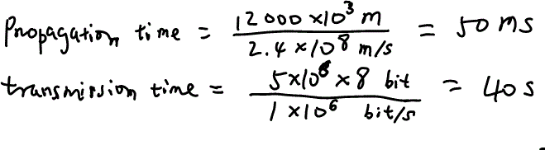
Note that in this case, because the message is very long and the bandwidth is not very high, the dominant factor is the transmission time, not the propagation time. The propagation time can be ignored in most cases.

Slide 39
Thank you

